Slide 1
How to pitch

Slide 2

Pitch
Goal = Overwhelm the jury
  8 – 10 minutes

Slide 3
Circle of impact for presentations
(Albert Mehrabian, MIT)
Voice 38% Content 7% Body Language 55%

Slide 4

How to sound smart …
Notes:
https://www.youtube.com/watch?v=8S0FDjFBj8o&t=110s

Slide 5

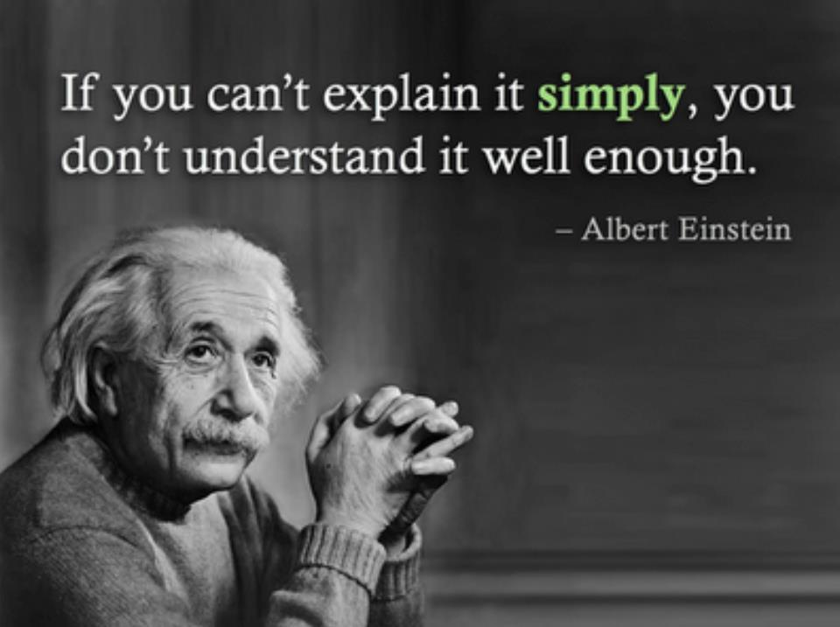
How to start?
Who is the jury
  What’s their goal?
What is your goal?
The actual instantation of the idea can vary dramatically over time based on the learning that happens along the way

Slide 6
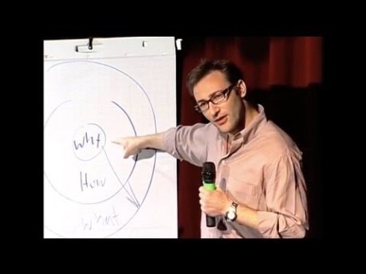
Storytelling: the power of a good story
Notes:
https://www.youtube.com/watch?v=u4ZoJKF_VuA&feature=youtu.be

Slide 7
Tips!
Don’t start with your powerpoint!
  First finish your story!
Text or Images ?
Graphs or numbers ?
Be creative!
What’s your goal?
Be enthousiastic!

Slide 8
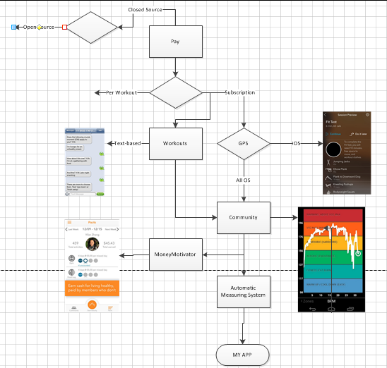
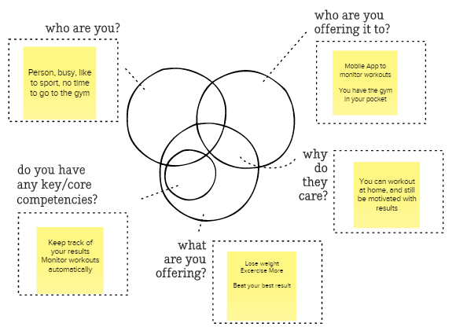
The Idea Maze

Slide 9
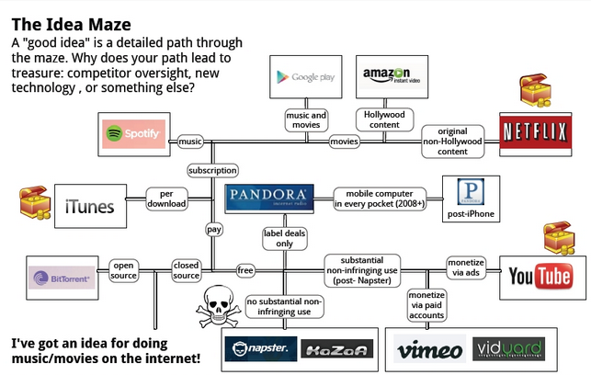
Development of an idea?
HAVING AN IDEA?
1) History. If your idea has been tried before (and almost all good ideas have), you should figure out what the previous attempts did right and wrong. A lot of this knowledge exists only in the brains of practitioners.
2) Direct experience. A lot of good startup founders figure out the maze through direct experience, often at work.

Slide 10
Strategy Plan
Monday
Tuesday
Wednesday
Thursday
Friday
- An x% increase in the number of visitors.
- Increase our visibility
- Sell our top 20 prodcucts to a wider market
-new technology experience
What do you want to get out of the app?
Who are your users?
What do your users want?
What experience are we trying to provide?
- Get as specific as possible
Good: 18-24 year old males in uvban areas of Europe with shoe size 44 and up
- Not good: young people with fashion sense
- Simple, straight forward, cheerfull and peppy,…
Be entertained, share photos,stories
- When does the store open and where are they exactly, and guide me to the store
- Give me extra info when I ‘m into a specific building (museum,..)
- What are their specific limitations?
* fontsize, type, colors,..

Slide 11
Scope
Monday
Tuesday
Wednesday
Thursday
Friday
What features will the app need to include?
What kind of detail will those features have?
What tools, skills and personnel will we need to build our app
What is the timeline?
Project Management : “Iterative” ( Agile ) versus waterfall, ...
“Specificatie – Design & Implementation – Testing – Deployment”

Slide 12

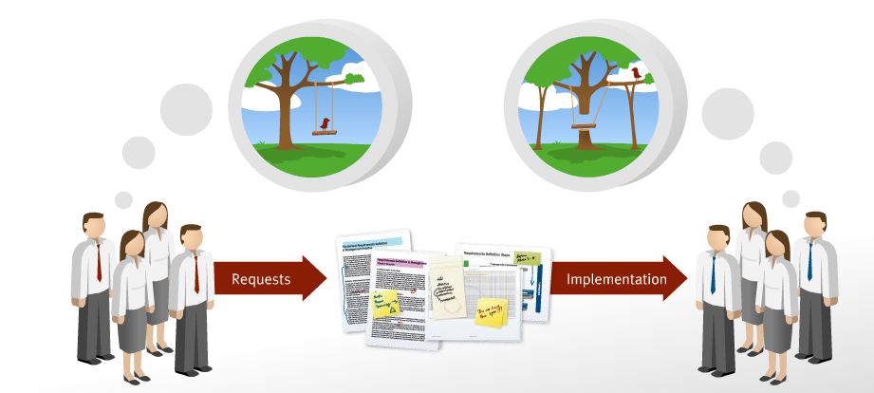
Difficult? In an International context
Different language
Different background
Different cultures

Slide 13
What are the problems you could encountered in your projects regarding requirements?
What could be the consequences of these problems?

Slide 14
What are the problems you could encountered in your projects regarding requirements?
Missing requirements
Requirement creep (lose focus / scope – Changing requirements)
Not well defined requirements
Contradictory requirements

Slide 15
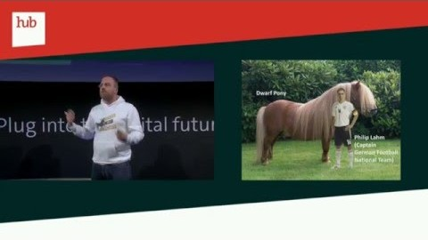
Notes:
https://www.youtube.com/watch?v=QIoRpNRog_0&t=18s

